Slide 1




JEDI
Flip Fit APP
Our product, how it works, and more

Slide 2



Garima
FlipFit
Kanika
Meet the Team
Kunal
Nikhitha
Urvisha

Slide 3
Sponsers: Flipkart
FlipFit
Stakeholders
SME: Amit Kumar Balyan
Coordinators: Sharath Ramesha

Slide 4

Agenda
1
Introduction
Problem Statement
Features
User Stories
Proposed Solution
UML Diagrams
Tech Stacks
1
2
3
4
5
6
Flip-Fit
7

Slide 5
Problem Statement
Flip-Fit App: Revolutionizing Your Workout Experience
Design a Ul and a backend system for a new enterprise application that Flipkart is launching. FlipFit. Flipkart is partnering up with gyms across Bangalore to enter into the fitness space.

Slide 6
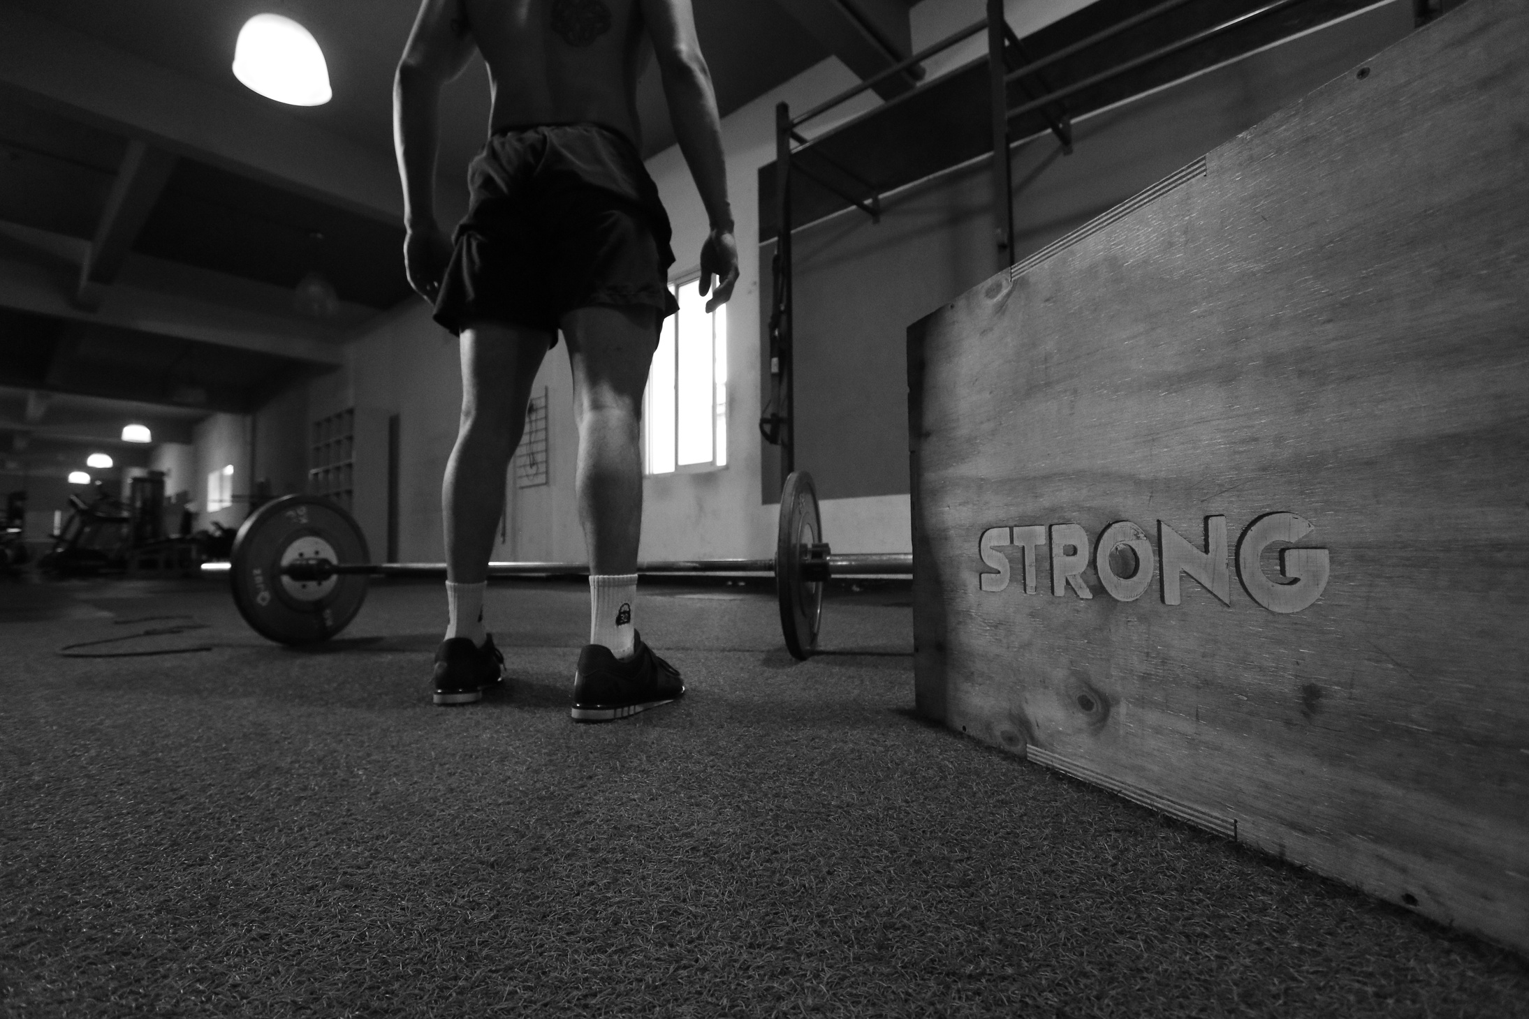
Features
Multiple centers
Fixed time slots and seat availability
User operations: Register, View, Book
Admin inputs slot info
This slide outlines the core challenges and requirements of FlipFit, emphasizing the need for a solution to manage gym bookings effectively.
Flip Fit App

Slide 7

User Stories
View all gym centres
View suitable slot:
View my bookings
Book a slot
Cancel booking
CUSTOMER:
View gym centre(s)
View gym owner(s)
View/Handle pending approvals
ADMIN:
Add new gym Centres
Add slots in gym Centres
Request admin approval for centres
View My gym Centres
Gym Owner:
Flip Fit App

Slide 8
Best Practices
Developed structured processes
Maintained code efficiency
Created UML Diagrams
Added Comments
Clean code
Used git for interactive and collaborative development
Flip Fit App

Slide 9
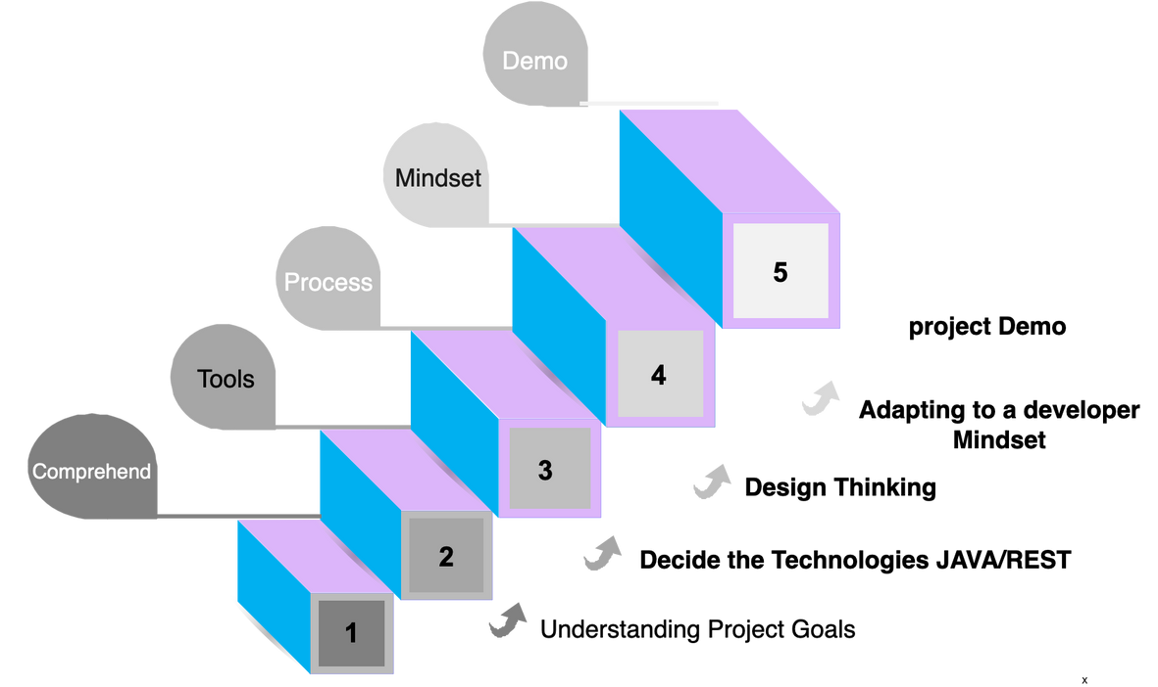
Our Journey

Slide 10
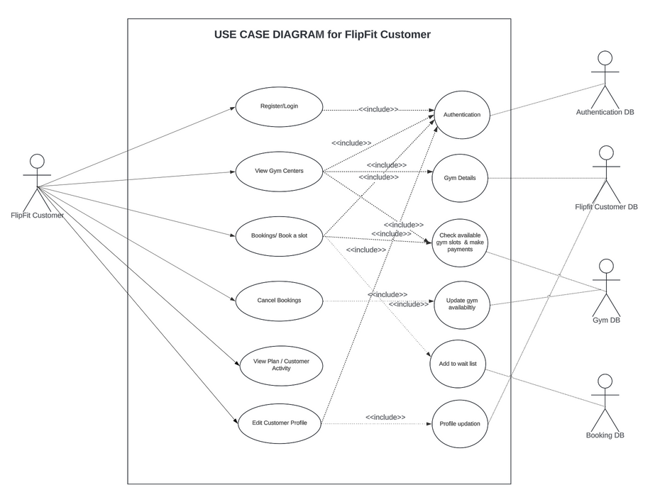
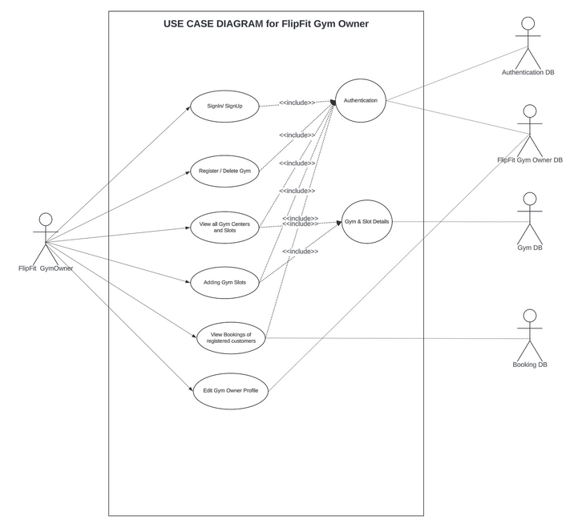
UML Diagrams
Use Case Diagrams

Slide 11
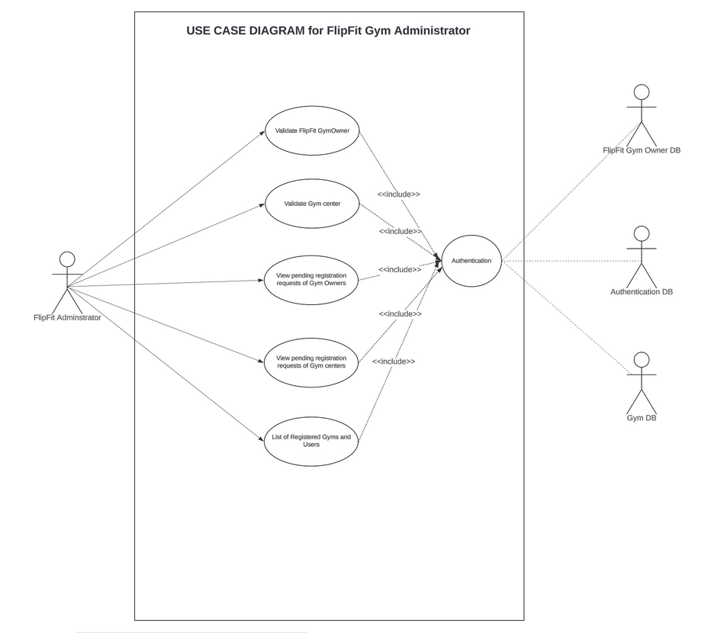
Use Case Diagrams

Slide 12
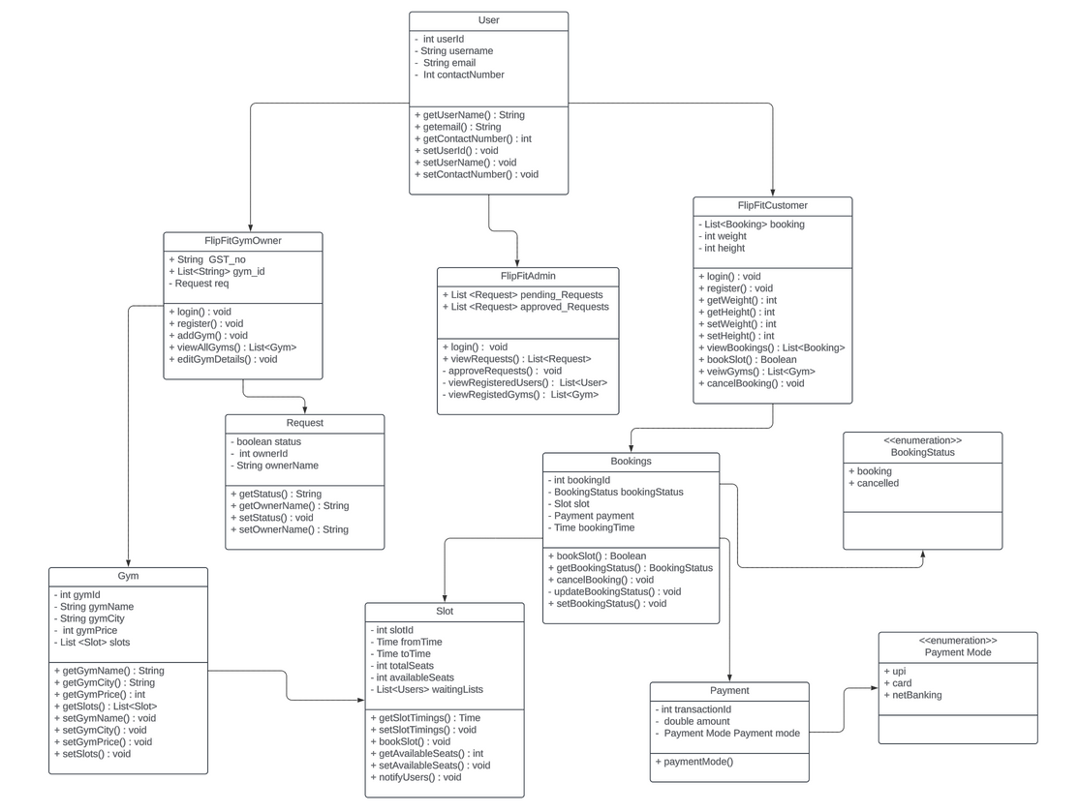
Class Diagram

Slide 13
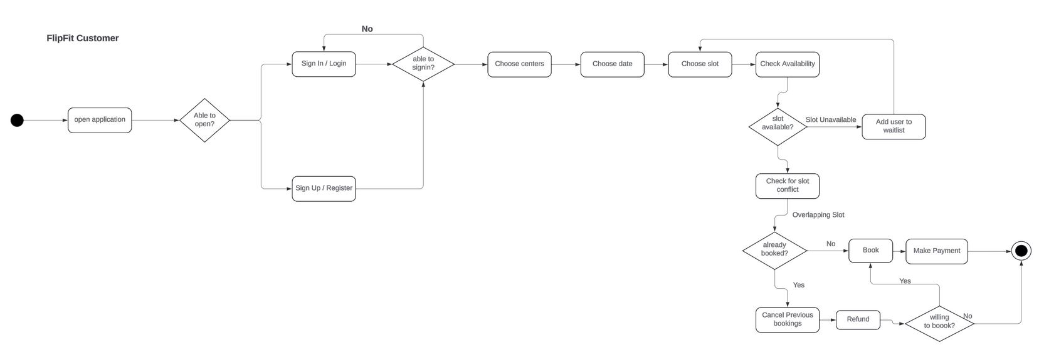
Activity Diagram

Slide 14
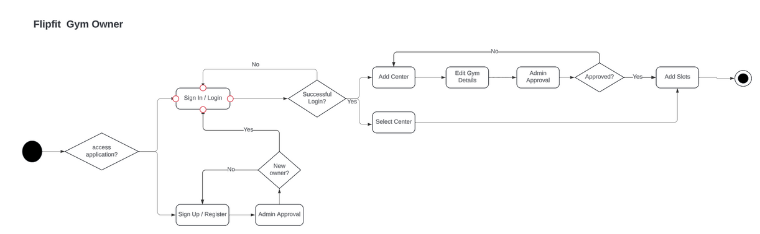
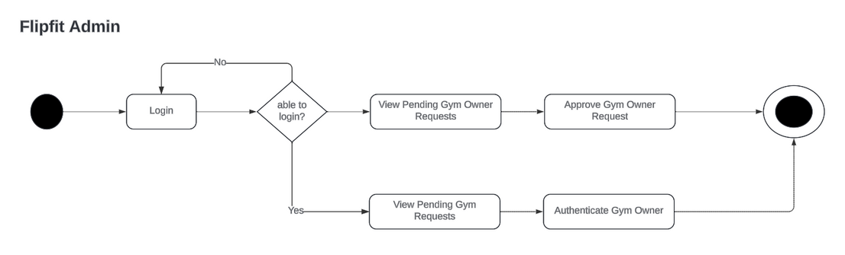
Activity Diagram

Slide 15







Tech Stack

Slide 16
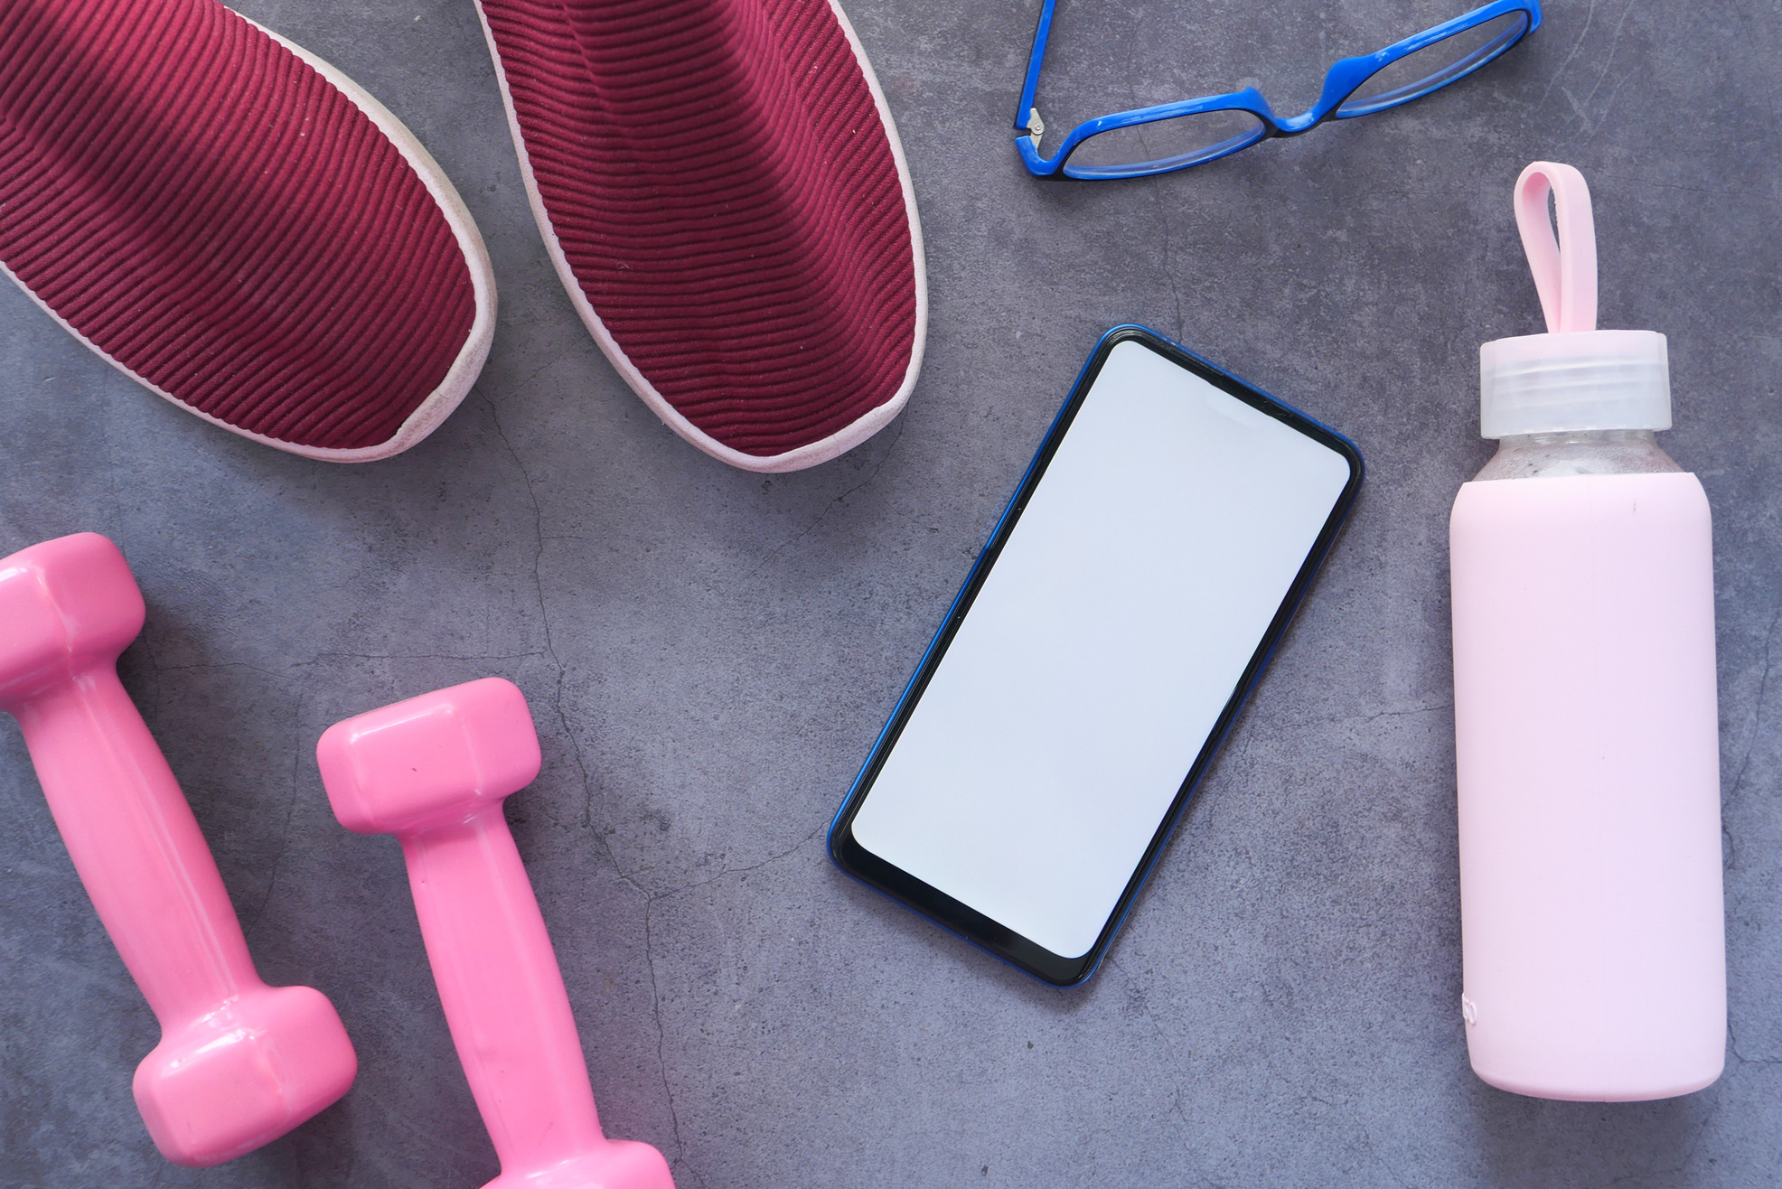
DEMO

Slide 17

Challenges and learnings

Slide 18

Thank you

